Slide 1



Scheduling Stochastic Traffic With
End-to-End Deadlines in
Multi-hop Wireless Networks
Christos Tsanikidis, Javad Ghaderi Columbia University, New York, NY, USA {c.tsanikidis, jghaderi}@columbia.edu
This article has been accepted for publication in Infocom 2024.
汇报人：莫露莎

Slide 2

Introduction
1
Problem
focused on worst-case traffic scenarios, yielding pessimistic approximation ratios.
hold asymptotic regime when the time, network bandwidth, and packet arrival rates are scaled to infinity.
Related work
Deadline-constrained scheduling in wireless network has mainly focused on single-hop traffic,
such as the Max Weight Scheduling, the polynomial-time algorithm, and so on.
The work on multi-hop traffic has mainly focused on wired networks (no interference).
[3] consider the worst-case traffic setting and provide algorithms that achieve
approximation ratio.
[4] proposes an algorithm that is analyzed for the case that the capacity constraints (number of used channels) are relaxed to hold only on average as opposed to strictly at each time.
自强不息 厚德载物
[3] Online scheduling and routing with end-to-end deadline constraints in multihop wireless networks.
[4] Adaptive csma for decentralized scheduling of multi-hop networks with end-to-end deadline constraints.
Central South University

Slide 3
Introduction
1
This paper provide the first algorithms that yield strong approximation guarantees in a non-asymptotic regime (finite time horizon, finite number of channels, finite arrival rates).
Contributions
introduce a near-optimal algorithm for wireless networks with general interference graph for the problem of scheduling packets with hard deadlines in multi-hop wireless networks.
propose a more efficient greedy maximal scheduling with probabilistic forwarding algorithm than the near-optimal algorithms.
show an efficient near-optimal algorithms in perfect graphs for the important class of perfect interference graphs.
自强不息 厚德载物
Central South University

Slide 4
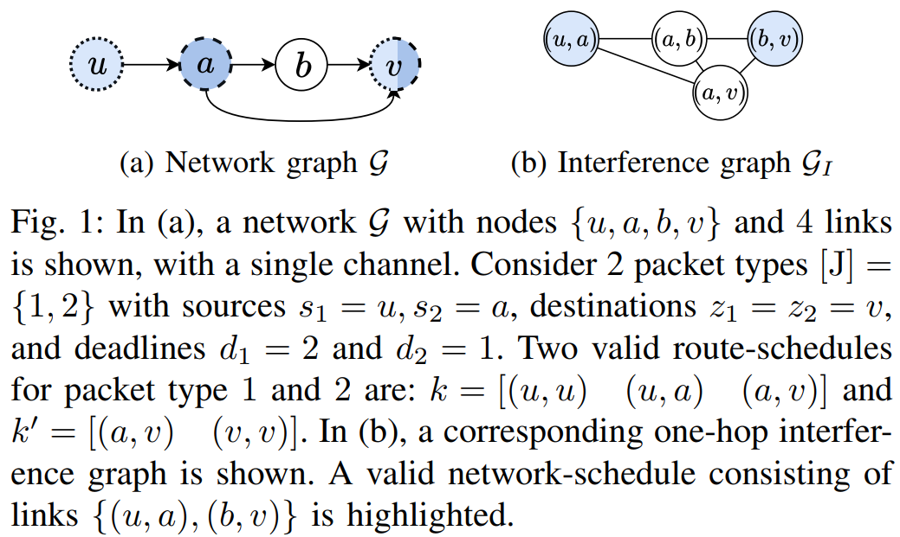
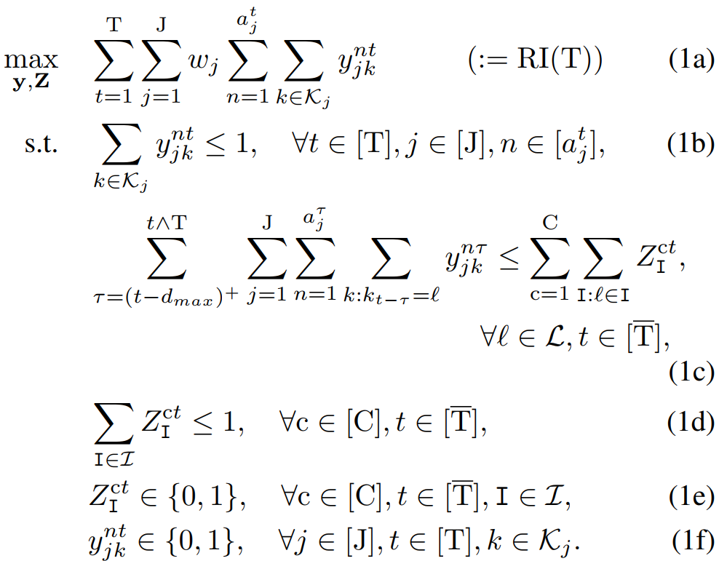
Model and definitions
2
independent set
Network graph and inference graph
Route-Schedule
The scheduling algorithm must determine which links are activated in each channel at each time slot.
Network-Schedule
A network schedule at a time slot t is a collection of C maximal independent sets on the interference graph GI.
Optimization
To maximize the weighted sum of the packets that are successfully delivered from their sources to their destinations within their deadlines.
Central South University

Slide 5
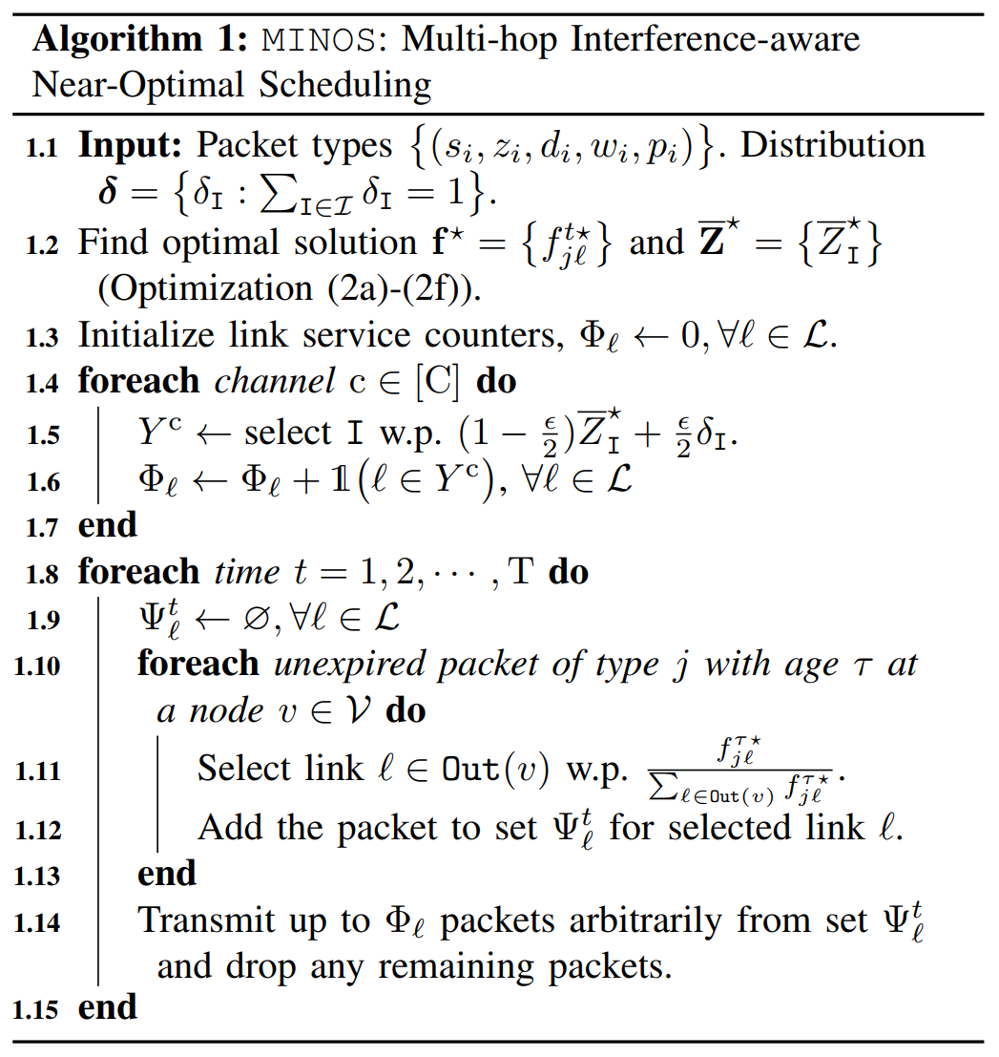
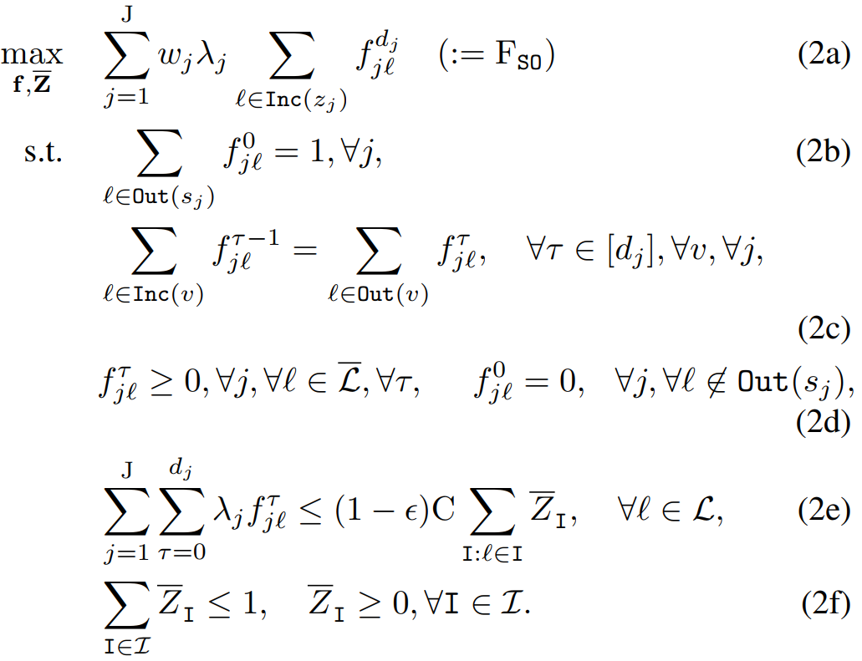
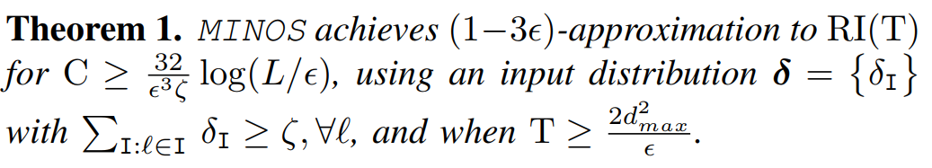
Algorithms and main results
3
Near-Optimal Algorithm for General Interference Graphs
Central South University

Slide 6
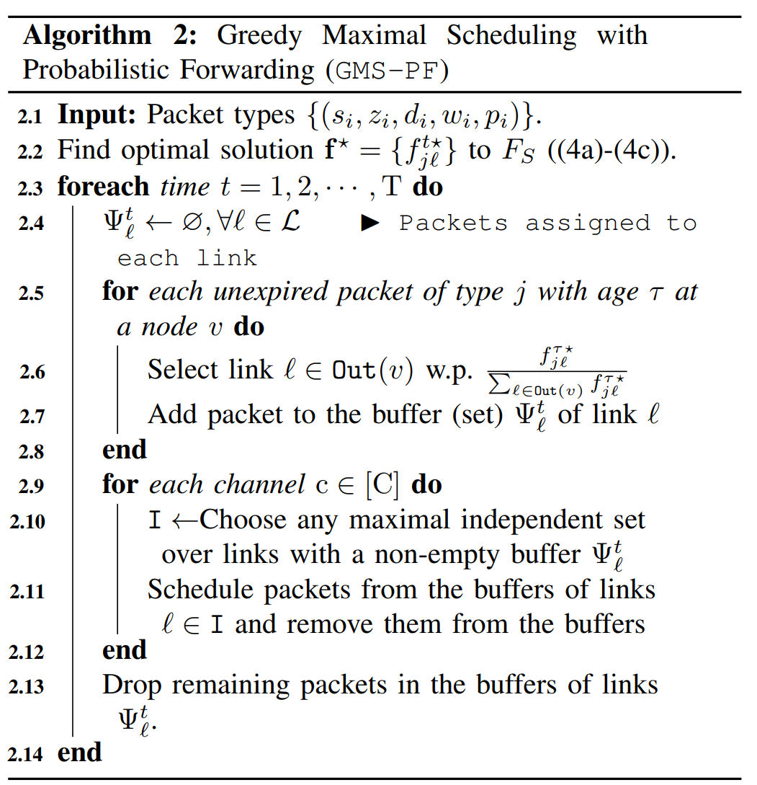
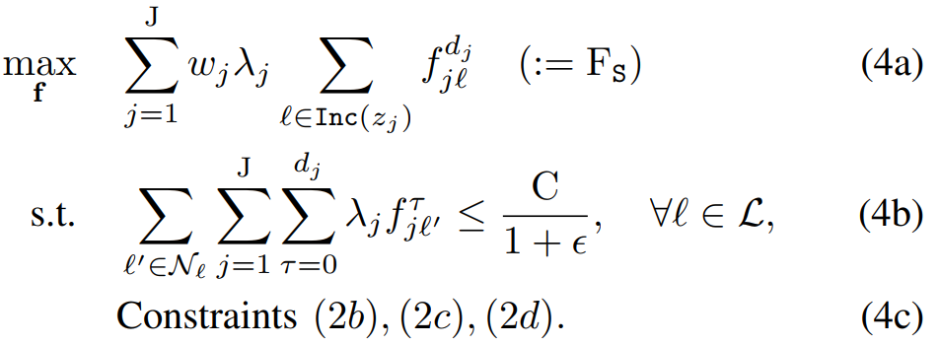
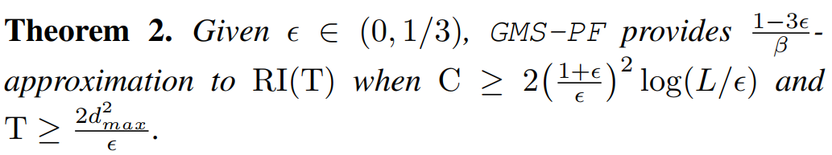
Algorithms and main results
3
Greedy Maximal Scheduling with Probabilistic Forwarding
Central South University

Slide 7
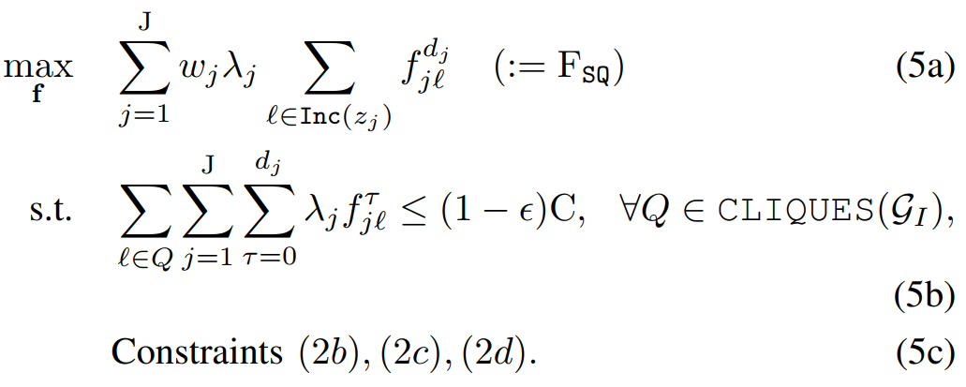
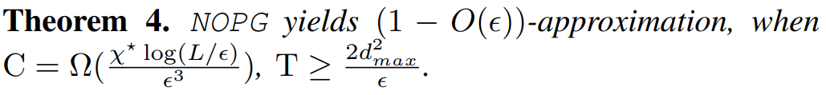
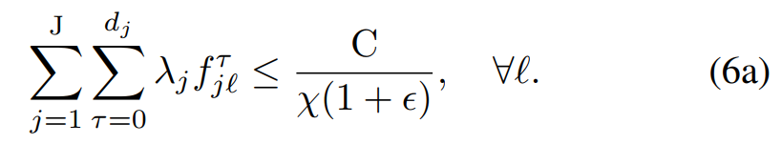
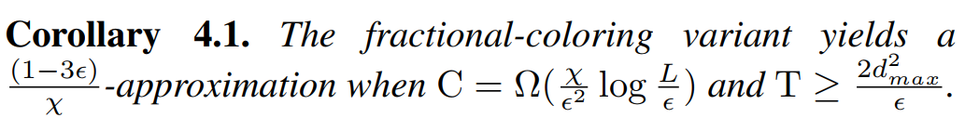
Algorithms and main results
3
Efficient Near-Optimal Algorithm for Perfect Graphs
leverage the ellipsoid algorithm to solve RI(T) near optimally.
it considers a constraint on the scheduled packets on
each maximal clique Q ∈ CLIQUES(GI)
limiting the average number of packets in every clique to C
Fractional-Coloring-Based Approximation Algorithms
given a fractional coloring of GI
selecting independent sets based on the fractional coloring distribution, the expected number of independent sets that include each link is C/χ .
Central South University

Slide 8
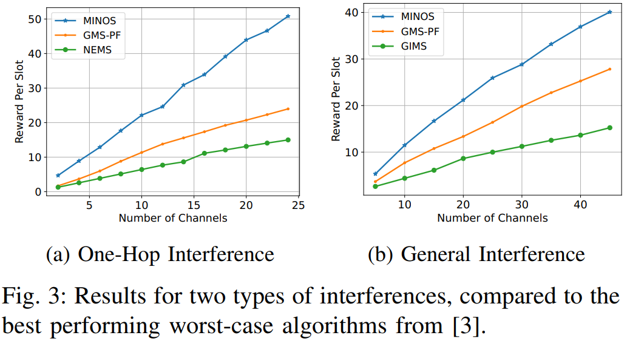
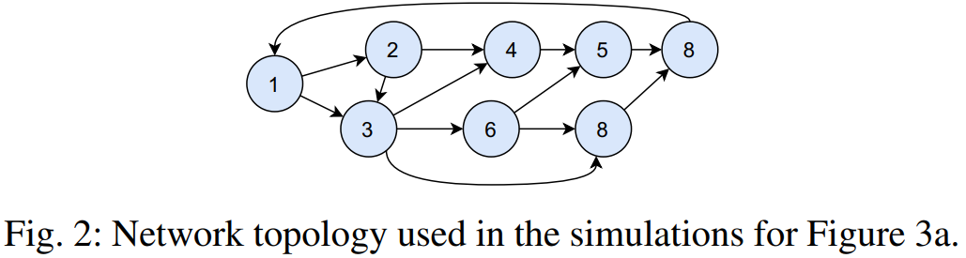
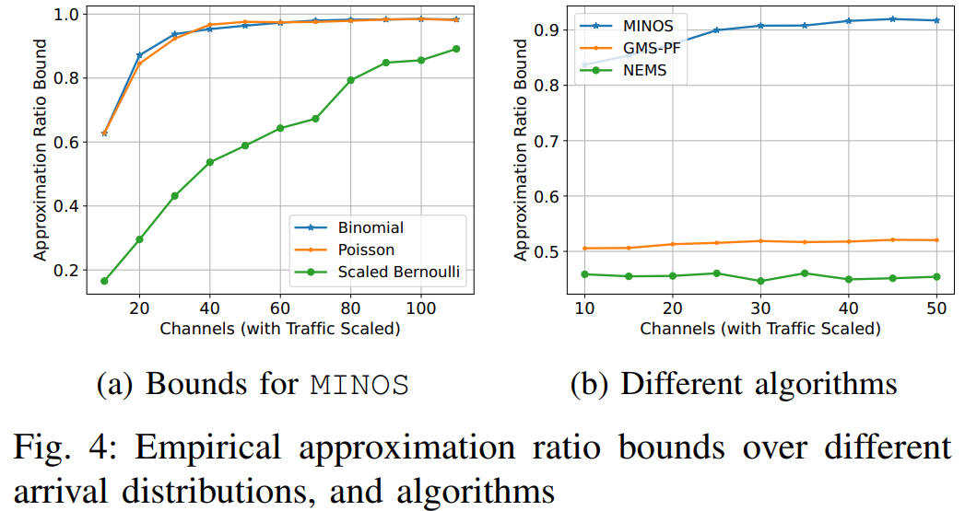
Simulation results
4
Best Performance
Evaluation under one-hop interference and general interference graphs
Evaluation of approximation ratio bounds
An upper bound on the optimal reward of the optimal for RI(T), which only depends on the arrival rates of the traffic distribution.
Central South University

Slide 9

Thanks

